Slide 1

ECG DATA COMPRESSION USING OPTIMUM QMF BANK
Multi Rate Signal Processing
Submitted to:
Asst. Prof. Avinash Ratre
Submitted by:
Sumedha (2K19/SPD/17)
Sudiksha Shukla (2K19/SPD/25)

Slide 2
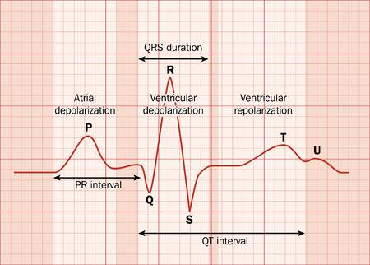
INTRODUCTION
Electrocardiography (E.C.G.) :
ECG is the recording of electrical activity of the heart.
It is a bioelectric signal generated by the human heart, by the action of depolarization and repolarization of cardiac cells.

Slide 3
NEED FOR ECG DATA COMPRESSION :
A computerized system of biological signal processing requires a huge amount of data, it is very difficult to store and process these signals.
Hence, we need a way to reduce the amount of data storage, and this needs to be done keeping their critical clinical content in order to rebuild the signal.
Compressing information reduces the transport time and the storage space and reduces the memory capacity in portable systems.
It increases the number of channels to be transferred and broadens the bandwidth.
ECG data compression is very important because it reduces the storage requirement for future diagnosis of a cardiac patient and plays an important role in efficient transmission in telemedicine and e-health care systems.
ECG data compression techniques are classified into two types, i.e., lossy and lossless. In lossy compression techniques, the reconstructed signal is not an exact replica of the original input signal.

Slide 4
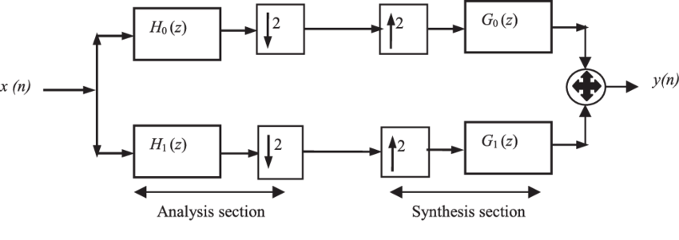
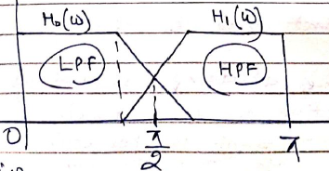
Quadrature Mirror Filter :
A quadrature mirror filter is a filter whose magnitude response has mirror image symmetry about π/2 frequency.
For QMF to behave as a LTI system:
Ho(w) = H(w) is an LPF
H1(w) = H(w-π) -> mirror-image HPF.
Go(w) = 2*H(w) -> LPF
G1(w) = -2*H(w-π) -> HPF

Slide 5
ROLE OF QMF BANK FOR ECG DATA COMPRESSION :
In this project data compression technique is based on the optimum two channel quadrature mirror filter (QMF) bank .
Data compression is done by decomposing the signal using optimum QMF bank and truncating the irrelevant coefficients using level thresholding.
Here, a Kaiser window is used to obtain the coefficients of the filter bank.
Linear optimization technique is employed for optimization of filter coefficients.
Run-length encoding is used to improve the compression without loss of significant information.
Following conditions need to be fulfilled :
Suitable optimization is needed to design a QMF bank for avoiding amplitude distortion.
FIR filter must be chosen for removing phase distortion.
All the analysis and synthesis filters must be designed in such a way so that no aliasing distortion is produced.

Slide 6
DATASET USED :
Link for Dataset: https://www.physionet.org/static/published-projects/apnea-ecg/apnea-ecg-database-1.0.0.zip
Details:
The data in this directory have been contributed by Dr. Thomas Penzel of Phillips-University, Marburg, Germany.
The data consist of 70 records, divided into a learning set of 35 records , and a test set of 35 records.
Recordings vary in length from slightly less than 7 hours to nearly 10 hours each.
Each recording includes a continuous digitized ECG signal
The files with names of the form rnn.dat contain the digitized ECGs
The .hea files are header files that specify the names and formats of the associated signal files
The qrs files are machine-generated (binary) annotation files

Slide 7
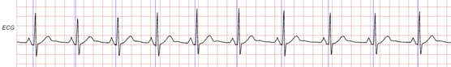
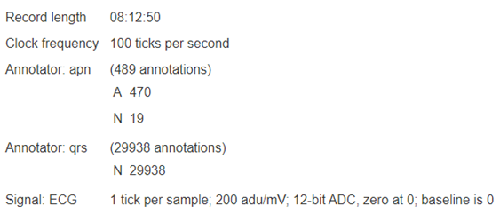
DATASET VISUALIZATION :

Slide 8
FLOWCHART
START
READING THE ECG WAVEFORM IN MATLAB
PREPROCESSING THE ECG WAVEFORM
ANALYSE THE FILTER BANK STRUCTURE
FILTER DESIGN
ALIASING CANCELLATION
OPTIMIZATION
SIMULATION
QUANTIZATION
OBTAINING RECONSTRUCTED SIGNAL
CALCULATING ERROR B/W ORIGNAL & RECONSTRUCTED SIGNAL
STOP

Slide 9
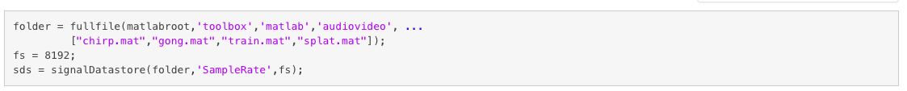
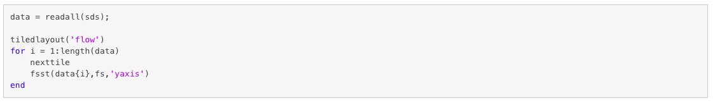
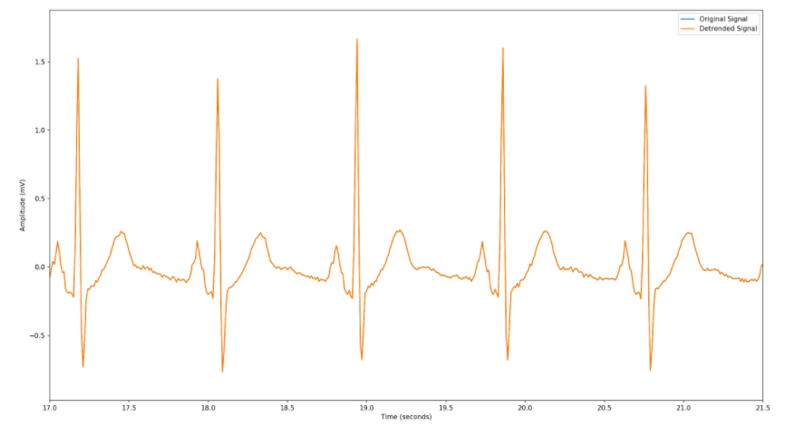
READING THE ECG WAVEFORM IN MATLAB
Code:
Output:

Slide 10
PRE-PROCESSING RAW WAVEFORM IN MATLAB
STEPS:
Reducing the amount of information in the signal prior to compression so that it intuitively improves the compression ratio.
In pre-processing step we have removed the DC offset ( This is generally not considered useful information )
Code:

Slide 11
PRE-PROCESSING RAW WAVEFORM IN MATLAB
OUTPUT:
Since the signal has very little drift or DC offset, so detrending effectively makes no difference
Pre-processed signal is similar to original one

Slide 12
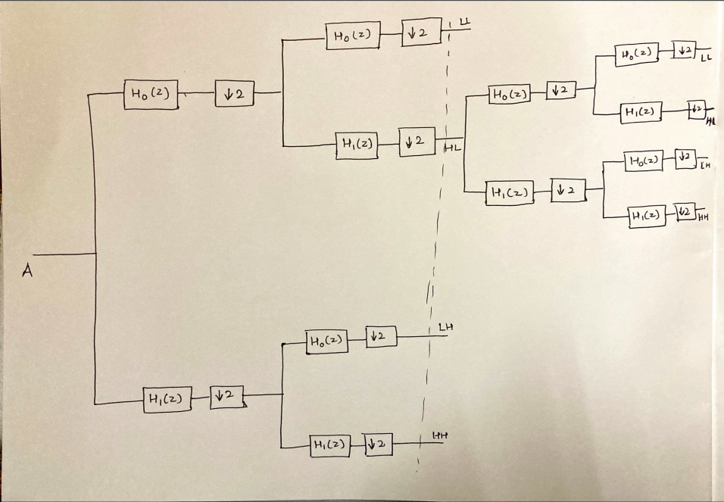
ANALYSIS OF FILTER BANK STRUCTURE
The filter bank tree structure is as follows:

Slide 13
FILTER DESIGN
The basic idea to design this system is to make the reconstruction as perfect as possible. In order to do this, we divided filter design in 3 steps
𝑃𝑒𝑟𝑓𝑒𝑐𝑡 𝑅𝑒𝑐𝑜𝑛𝑠𝑡𝑟𝑢𝑐𝑡𝑖𝑜𝑛 :
(1) 𝐴𝑙𝑖𝑎𝑠𝑖𝑛𝑔 𝐶𝑎𝑛𝑐𝑒𝑙𝑙𝑎𝑡𝑖𝑜𝑛
(2) 𝑃ℎ𝑎𝑠𝑒 𝐷𝑖𝑠𝑡𝑜𝑟𝑡𝑖𝑜𝑛
(3) 𝐴𝑚𝑝𝑙𝑖𝑡𝑢𝑑𝑒 𝐷𝑖𝑠𝑡𝑜𝑟𝑡𝑖𝑜𝑛
ALIASING CANCELLATION:
Following conditions need to be met for aliasing cancellation:
{ 𝐹0 (𝑧) = 𝐻1(−𝑧) 𝐹1 (𝑧) = −𝐻0(−𝑧)
Which is equivalent to 𝐻1 (𝑧) = 𝐻0 (−𝑧) => ℎ1 (𝑛) = (−1) 𝑛ℎ0(𝑛)
And the cancellation requirements above become: { 𝐹0 (𝑧) = 𝐻0(𝑧) 𝐹1 (𝑧) = −𝐻0(−𝑧)
If we translate these into time domain, we have:
ℎ1 (𝑛) = (−1) 𝑛ℎ0(𝑛) { 𝑓0 (𝑛) = ℎ0(𝑛) 𝑓1 (𝑛) = −(−1) 𝑛ℎ0(𝑛)
According to this relationship, we can generate ℎ1 (𝑛), 𝑓0 (𝑛), 𝑓1 (𝑛) from ℎ0(𝑛)

Slide 14
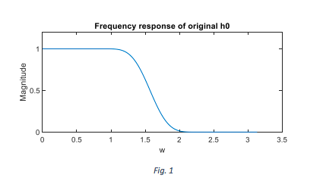
FILTER DESIGN
We chose Kaiser window as a basic model to design ℎ0 (𝑛) because of the flexibility.
Comparing to other window filters, the ripple shape of Kaiser window is much easier to control and modify with filter coefficients, N and β. The coefficients we start from are N = 29, Fc = 0.5, β = 9.
We chose Kaiser window as a basic model to design ℎ0 (𝑛) because of the flexibility.
Comparing to other window filters, the ripple shape of Kaiser window is much easier to control and modify with filter coefficients, N and β. The coefficients we start from are N = 29, Fc = 0.5, β = 9.
CHOOSING KAISER WINDOW:

Slide 15
FILTER DESIGN
PHASE DISTORTION:
This is not really a problem. ℎ0 (𝑛) is a FIR filter, so that it will not cause any phase distortion.
AMPLITUDE DISTORTION:
We can eliminate amplitude distortion if and only if
𝐻0(𝑧) has the form of: 𝐻0 (𝑧) = 𝑐0𝑧 −2𝑛0 + 𝑐1𝑧 −(2𝑛1+1)
However, in this case, the order of ℎ0(𝑛) filter is 1 which means if ℎ0 (𝑛) can offer good low pass response, amplitude distortion is inevitable.
To minimize amplitude distortion we go for optimization
Coefficients are chosen such that Er 𝑠ℎ𝑜𝑢𝑙𝑑 𝑏𝑒 𝑎𝑠 𝑠𝑚𝑎𝑙𝑙 𝑎𝑠 𝑝𝑜𝑠𝑠𝑖𝑏𝑙𝑒
𝐸𝑟 = ∑(𝐻 2 (𝜔) + 𝐻 2 (𝜋 − 𝜔) − 1) 2 𝜋 𝜔=0
𝐸𝑠 = ∑ 𝐻 2 (𝜔) 𝜋 𝜔=𝑠𝑡𝑜𝑝𝑏𝑎𝑛𝑑 , 𝑡ℎ𝑖𝑠 𝑟𝑒𝑓𝑒𝑟𝑠 𝑡𝑜 𝑒𝑛𝑒𝑟𝑔𝑦 𝑙𝑜𝑠𝑠 𝑜𝑢𝑡 𝑜𝑓 𝑠𝑡𝑜𝑝 𝑏𝑎𝑛d
OPTIMIZATION:

Slide 16
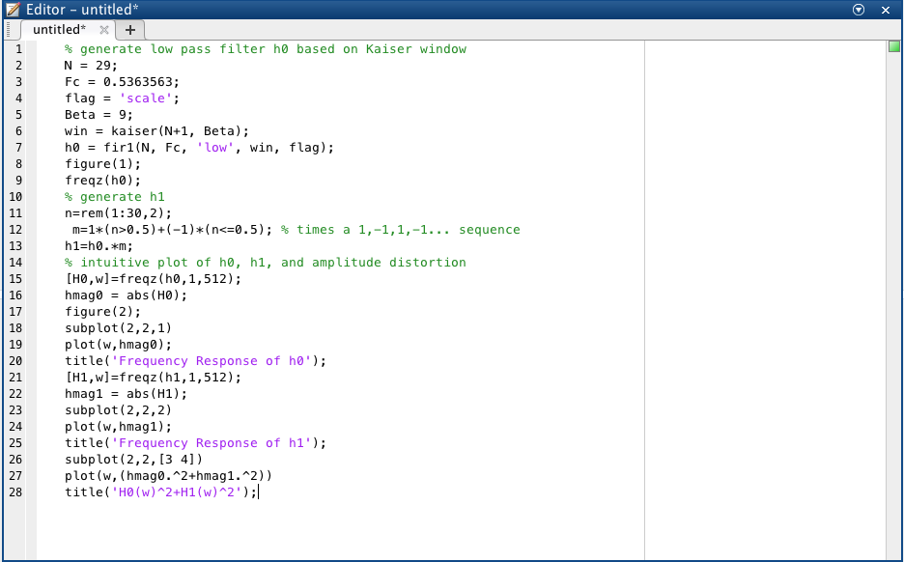
FILTER DESIGN
CODE FOR ALIASING CANCELLATION:

Slide 17
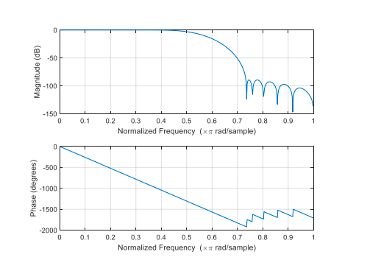
FILTER DESIGN
CODE FOR OPTIMIZATION:
FREQUENCY RESPONSE AFTER OPTIMIZATION:

Slide 18
FILTER DESIGN
SIMULATION:
The basic idea of simulation is to choose an input signal x(n), make it go through the QMF system and generate the output signal 𝑥̂(𝑛).
The method we used for up-sampling by 2 is inserting zeros. This will result in a magnitude reduction in time domain by 2 after the second convolution in f0 and f1 filter. So, when we calculate the absolute error between input and output, 𝑥̂(𝑛) must be multiplied by 2 before deducting x(n).
The length of x(n) (input signal) and 𝑥̂(𝑛) (output signal) are different because of convolution. 𝑥̂(𝑛) is 2*length(h0) pads longer than x(n). As a result, we need to choose the specific part of 𝑥̂(𝑛) to calculate the absolute error.

Slide 19
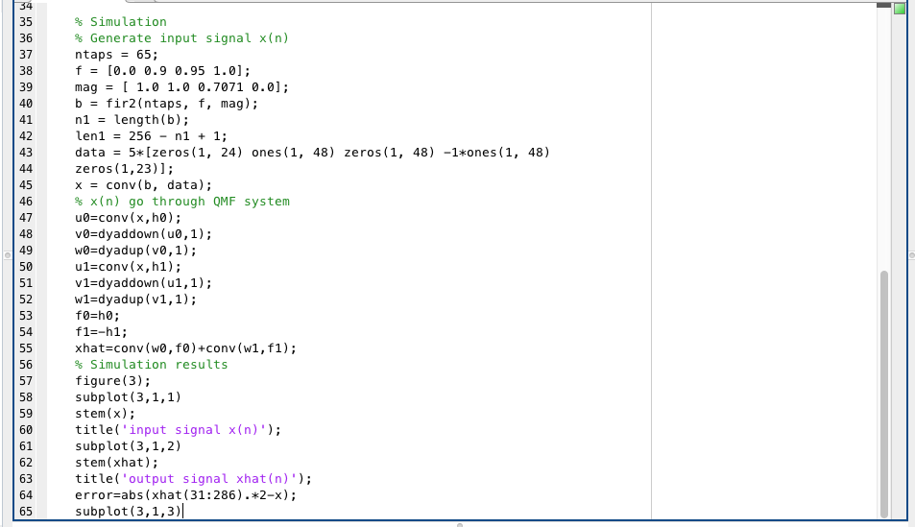
FILTER DESIGN
CODE FOR SIMULATION AND CALCULATING ERROR BETWEEN ORIGNAL SIGNAL AND RECONSTRUCTED SIGNAL:

Slide 20
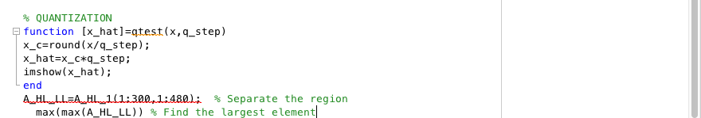
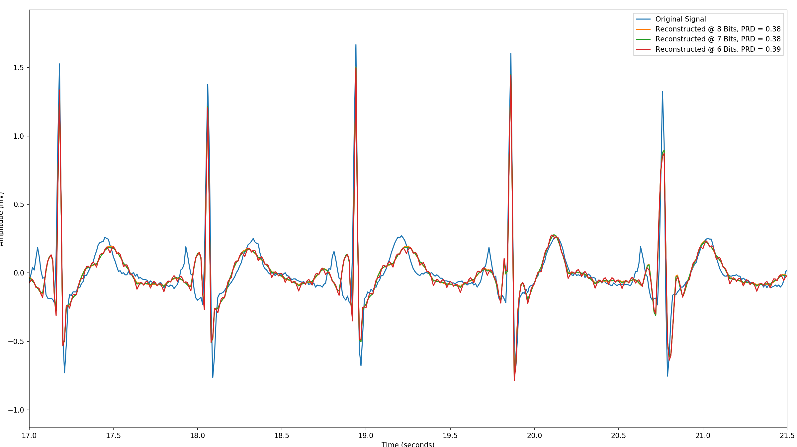
QUANTIZATION
CODE:
OUTPUT AFTER QUANTIZATION:
Plots of reconstructed signals vs number of bits used for quantization

Slide 21
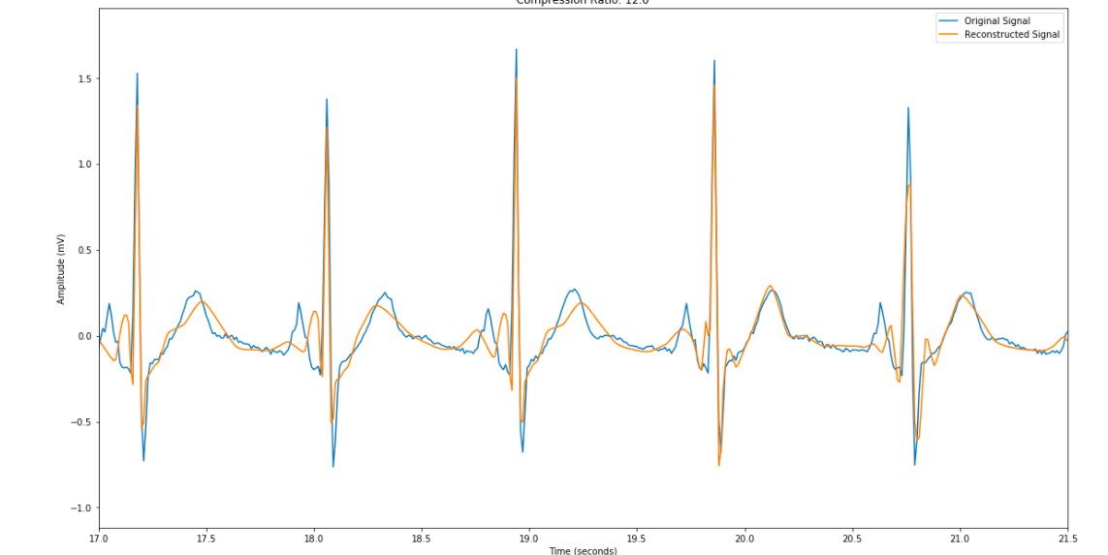
OUTPUT
Original Signal vs Reconstructed Signal

Slide 22
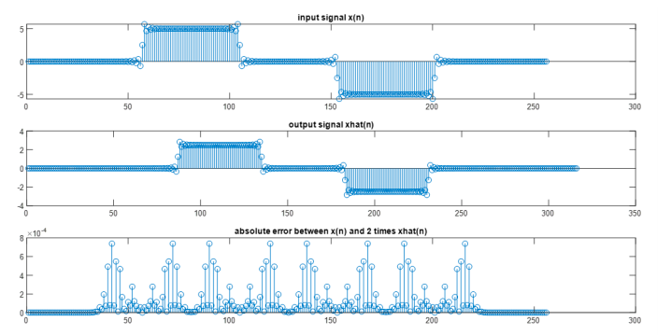
ERROR BETWEEN ORIGNAL SIGNAL AND RECONSTRUCTED SIGNAL

Slide 23
CONCLUSION
ECG data compression plays a key role in various systems viz., Holter monitor system, mobile ECG and telemedicine and e-health care system.
Here, an algorithm based on the optimum QMF bank and RLE is presented for the ECG data compression.
The first step of this work is to design optimum QMF filter bank, in which optimization is done using a linear function.
Second step is to apply an ECG signal to optimum QMF bank to decompose it into different frequency bands.
The coefficients truncation is done after applying a level thresholding.
Further, RLE algorithm is used to improve the performance.
Quantization is done to "filter out" some high frequency components in the process and make the signal less messy.
We have obtained the error between original and reconstructed signal and noticed that the error is small. Hence, we are able to compress the data with no loss of useful information.

